Slide 1
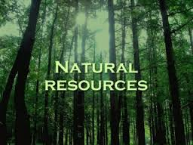
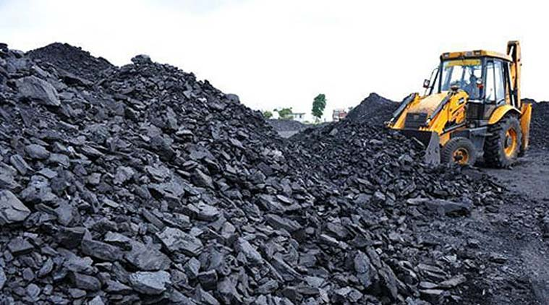
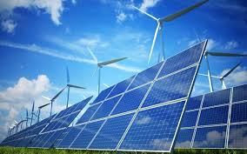
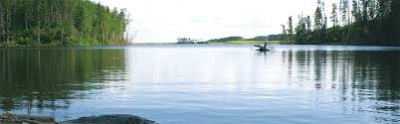
UNIT 2 NATURAL RESOURCES
2.1 INTRODUCTION
2.2 RENEWABLE AND NON-RENEWABLE RESOURCES.
Natural Resources- associated Problems of -
FOREST, WATER, MINERAL,FOOD, ENERGY, & LAND RESOURCES
2.3 ROLE OF AN INDIVIDUAL IN CONSERVATION OF NATURAL RESOURCES
2.4 EQUITABLE USE OF RESOURCES -SUSTAINABLE LIFESTYLES

Slide 2
2.1 Introduction to Natural Resources
Natural resources are resources that exist without actions of humankind.
Natural resources are useful raw materials that we get from the Earth. They occur naturally, which means that humans cannot make natural resources.
Instead, we use and modify natural resources in ways that are beneficial to us.

Slide 3
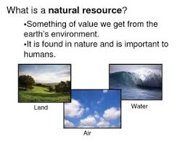
Introduction
The Materials or substances occurring in nature which can be used for human needs are called NATURAL RESOURCES.
Examples: Sunlight, AIR, WATER , Soil,, PLANTS , ANIMALS ( Renewable resources)
Minerals, Coal Oil & Natural gas (Non Renewable Resources).

Slide 4
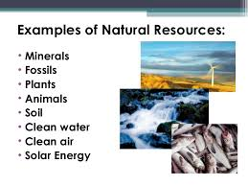
Natural resources are- Biotic / Abiotic
The natural resources include, air, water, soil, minerals, along with the climate and solar energy, which form the non-living or ‘abiotic’ part of nature.
The ‘biotic’ or living parts of nature consists of plants and animals, including microbes(Bacteria, viruses, fungi).

Slide 5
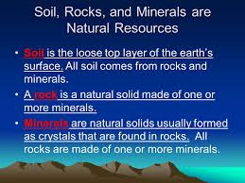
Biotic natural resources also include fossil fuels such as coal and petroleum which are formed from organic matter that has decayed.
Abiotic: these resources come from non-living and non-organic material. Examples : land, fresh water, air, and heavy metals (gold, iron, copper, silver, etc.).

Slide 6
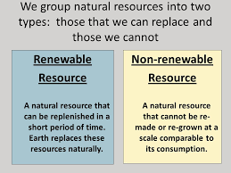
TYPES:

Slide 7

Renewable resources: An Endless Supply of Resources
Some natural resources are not used up.
Plants need sunlight, air, and water to grow.
We need air to breathe and water to drink.
These resources are not used up.
Sunlight, air, and water are always available.

Slide 8

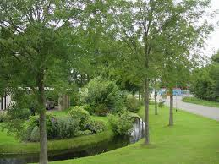
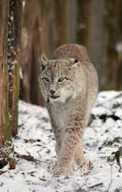
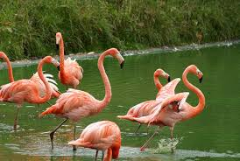
Renewable Resources

Slide 9
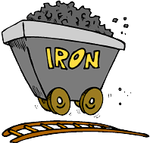
Non renewable resources: Resources That Cannot be Replaced
A nonrenewable resource is a resource that cannot be replaced.
Many natural resources come from below the ground.
Miners dig into the ground to get rocks called ores.

Slide 10
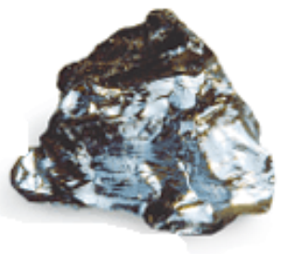
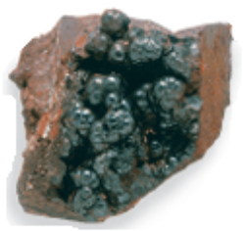
EXAMPLES OF NON- RENEWABLE RESOURCES
Hematite is an ore
that contains iron.
Coal forms from plants
that live many years ago.

Slide 11
NATURAL RESERVES OF INDIA
Extra Info.
India's major mineral resources include:
Coal (4th largest reserves in the world),
Iron ore, Manganese ore(7th largest reserve in the world as in 2013),
Mica, Bauxite (5th largest reserve in the world as in 2013),
Chromite, Natural gas, Diamonds, Limestone and Thorium (world's largest along coast of Kerala shores).

Slide 12

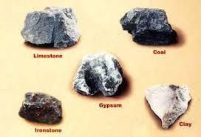
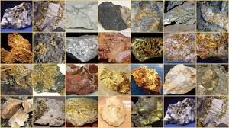
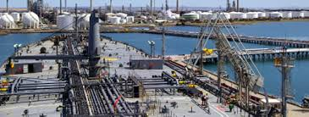
NATURAL RESOURCES EXAMPLES

Slide 13
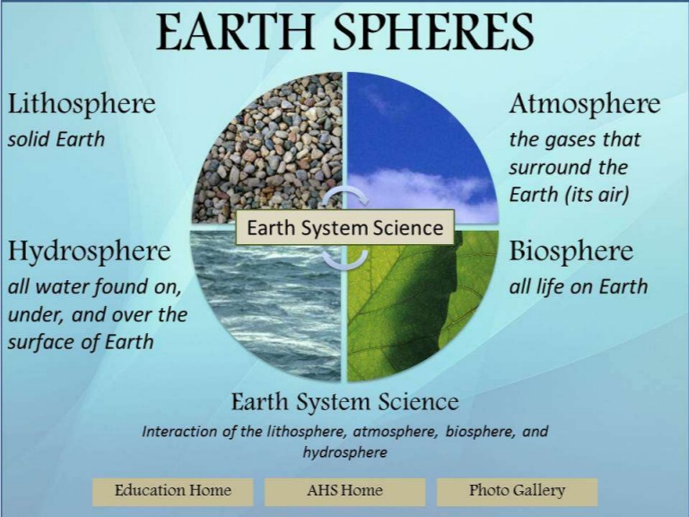
Earth’s Resources and Humans:
The resources on which mankind is dependent are provided by various sources or ‘spheres’.
1) Atmosphere
2) Hydrosphere
3) Lithosphere
4) Biosphere

Slide 14
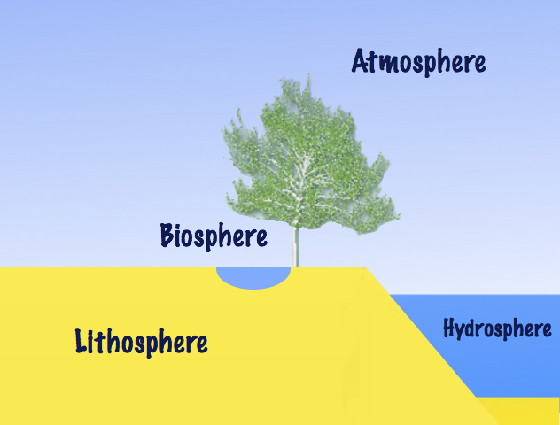
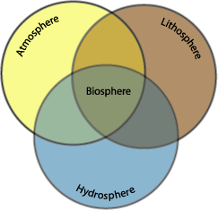
Resources on the earth :-
The natural resources of the earth are air, water, soil, minerals and living organisms.
The outer crust of the earth is the lithosphere. The water on the earth is the hydrosphere. The layer of the air around the earth is the atmosphere. Living organisms are found where the atmosphere, hydrosphere and lithosphere interact and is the biosphere.

Slide 15
Atmosphere
The atmosphere forms a protective shell over the earth . It is so much more than the air we breathe.
A trip from the surface of Earth to outer space would result in passing through five different layers, each with very different characteristics.
The lowest layer is Troposphere, the only part warm enough for us to survive in & is only 12 km thickness.
If the Earth were the size of an Apple, this troposphere is not thicker than an apple’s skin.
Earth’s atmosphere stretches from the surface of the planet up to as far as 10,000 kilometers (6,214 miles) above.
After that, the atmosphere blends into space.

Slide 16
Composition of Atmosphere
While oxygen is necessary for most life on Earth, the majority of Earth’s atmosphere is not oxygen.
Earth’s atmosphere is composed of :
78 percent nitrogen,
21 percent oxygen,
0.9 percent argon, and
0.1 percent other gases.- Trace amounts of carbon dioxide, methane, water vapor, and neon are some of the other gases that make up the remaining 0.1 percent.

Slide 17
Layers of atmosphere
The atmosphere is divided into five different layers, based on temperature.
1. Troposphere
2. Stratosphere
3. Mesoshere
4. Thermosphere
5. Exosphere

Slide 18
1. Troposphere
The layer closest to Earth’s surface is the troposphere, reaching upto 15 kilometers (five to 10 miles) from the surface.
The troposphere is thickest at the equator, and much thinner at the North and South Poles.
The majority of the mass of the entire atmosphere is contained in the troposphere—between approximately 75 and 80 percent.
Most of the water vapor in the atmosphere, along with dust and ash particles, are found in the troposphere—explaining why most of Earth’s clouds are located in this layer.
Temperatures in the troposphere decrease with altitude

Slide 19
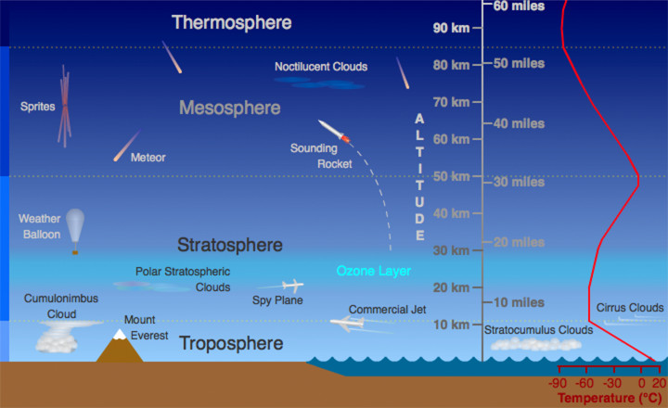
Atmosphere Layers

Slide 20
2. Stratosphere
The stratosphere is the next layer up from Earth’s surface.
It reaches from the top of the troposphere, which is called the tropopause, to an altitude of approximately 50 kilometers (30 miles).
Temperatures in the stratosphere increase with altitude.
A high concentration of ozone, a molecule composed of three atoms of oxygen, makes up the ozone layer of the stratosphere.
This ozone absorbs some of the incoming solar radiation, shielding life on Earth from potentially harmful ultraviolet (UV) light, and is responsible for the temperature increase in altitude.

Slide 21
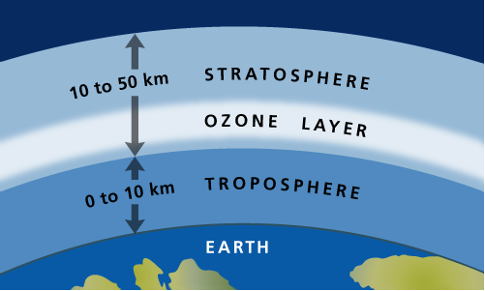
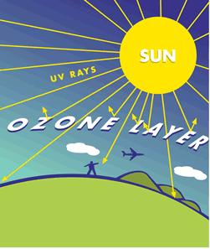
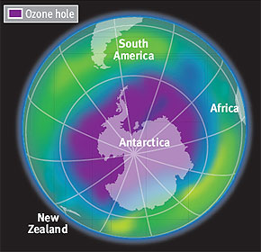

Slide 22
3. Mesosphere
The top of the stratosphere is called the stratopause.
Above that is the mesosphere, which reaches as far as about 85 kilometers (53 miles) above Earth’s surface.
Temperatures decrease in the mesosphere with altitude.
In fact, the coldest temperatures in the atmosphere are near the top of the mesosphere—about -90°C (-130°F).
The atmosphere is thin here, but still thick enough so that meteors will burn up as they pass through the mesosphere—creating what we see as “shooting stars.”
The upper boundary of the mesosphere is called the mesopause.

Slide 23
4. Thermosphere
The thermosphere is located above the mesopause and reaches out to around 600 kilometers (372 miles).
Not much is known about the thermosphere except that temperatures increase with altitude.
Solar radiation makes thermosphere very hot, reaching temperatures as high as 2,000°C the upper regions of the (3,600°F).
5.Exosphere
The uppermost layer, that blends with what is considered to be outer space, is the exosphere.
The pull of Earth’s gravity is so small here that molecules of gas escape into outer space.

Slide 24
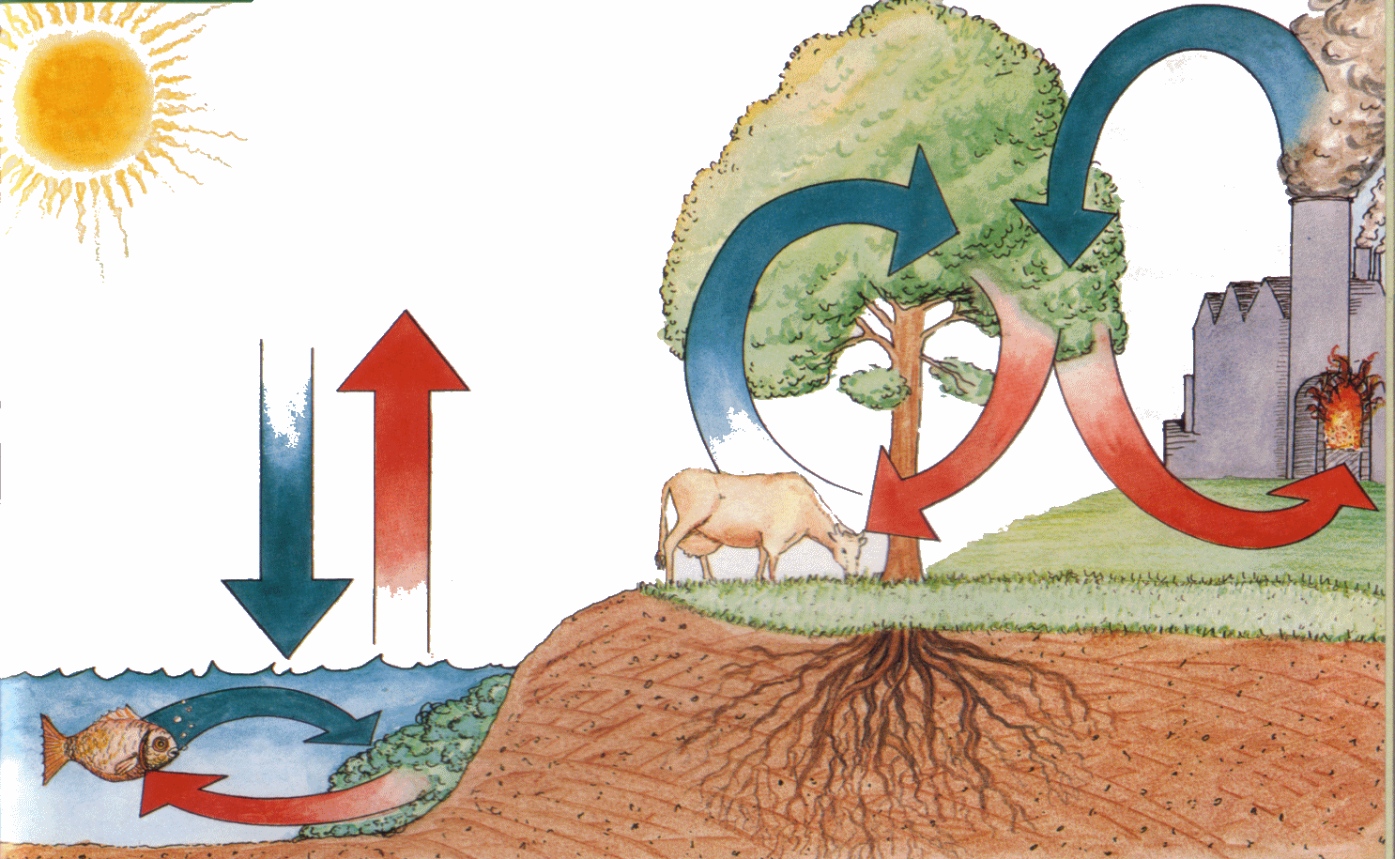
Air (Atmosphere) :-
Air is a mixture of gases like nitrogen, oxygen, carbon dioxide, water vapour and other gases.
During respiration living organisms use oxygen to break down glucose and get energy for their activities.
This results in the release of carbon dioxide. Burning of fuels also use oxygen and release carbon dioxide.
During photosynthesis green plants convert carbon dioxide into glucose in the presence of sunlight. This results in the release of oxygen.
These processes help to maintain the oxygen – carbon dioxide balance in nature.

Slide 25
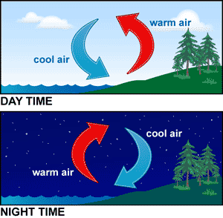
i) The role of atmosphere in climate control :-
The atmosphere covers the earth like a blanket. Air is a bad conductor of heat. It prevents sudden increase in temperature during the day and also slows down the escape of heat during the night. So the atmosphere keeps the average temperature of the earth fairly steady during the day and throughout the year.
ii) The movement of air (Winds) :-
When air gets heated, it rises up and produces low pressure and cool air moves in to take its place. The movement of air causes winds.
During the day the land gets heated faster than the sea.
So the hot air above the land rises up and cool air from the sea moves towards the land. During the night sea cools down slowly than the land. So the hot air above the sea rises up and cool air from the land moves towards the sea.

Slide 26
2 Hydrosphere (Water): A wonder liquid
A very large area of the earth’s surface is covered with water. Water is also found inside the earth, in the atmosphere as water vapour. The water in seas and oceans is saline. Fresh water is found in rivers, lakes, ponds and as ice and snow at the poles and mountains in cold regions.
All life processes and cellular activities need water. So all organisms need water to survive.
The amount of water and other factors like temperature and nature of soil decides the diversity of species and the number of individuals of each species in an area.
Water pollution :-
The increase in the content of harmful substances in water is called water pollution.
Water pollution is caused by addition of harmful substances like fertilizers and pesticides from farms, sewage from towns, cities and factories, harmful chemicals from factories, disease causing microorganisms, changes in the amount of oxygen dissolved in water or changes in the temperature of water.

Slide 27
3.LITHOSPHERE
The lithosphere began as a hot ball of matter which formed the earth about 4.6 billion years ago.
About 3.2 billion years ago, the earth cooled down considerably and a very special event took place - life began on our planet.
The crust of the earth is 6 or 7 kilometers thick and lies under the continents.
Of the 92 elements in the lithosphere only eight are common constituents of crustal rocks.
Of these constituents,
47% is Oxygen,
28% is Silicon,
8% is Aluminium,
5% is Iron,
Sodium, magnesium, potassium and calcium constitute 4% each.
Together, these elements form about 200 common mineral compounds.

Slide 28
b) Composition of soil :-
Soil is a mixture of rock particles, decayed organisms called humus, living organisms, minerals, air and water. The amount of minerals, humus, air and water are the factors which decides the biodiversity in that area.
c) Soil pollution :-
The addition of harmful substances which affects the fertility of the soil and kills the diversity of organisms living in it is called soil pollution.
Soil pollution is caused by the excessive use of fertilisers and pesticides.
It kills the organisms like earthworms and bacteria which makes the soil rich in humus.
The removal of useful components and addition of other harmful substances reduces the fertility of soil and causes soil pollution.

Slide 29
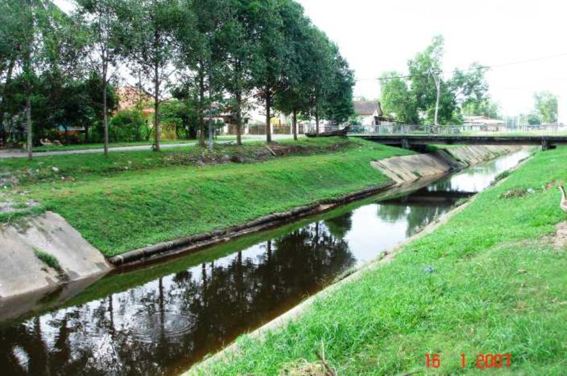
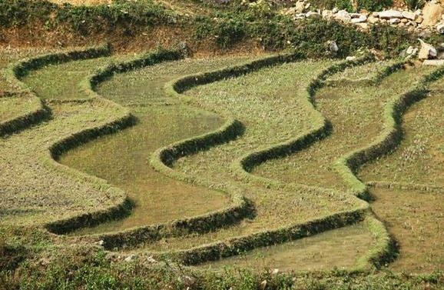
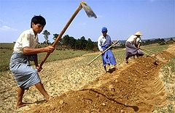
d) Soil erosion :-
The carrying away of soil from one place to the other by flowing water and wind is called soil erosion. Large scale deforestation also causes soil erosion.
Soil erosion can reduced or prevented by vegetative cover on the ground, afforestation, construction of bunds, terraces, dams etc.
Activity :- Effect of flowing water on top soil.
.

Slide 30
4) Biosphere
Food, from crops and domestic animals, providing human metabolic requirements.
Food, for all forms of life which live as interdependent species in a community and form food chains in nature on which man is dependent.
Energy needs: Biomass fuel wood collected from forests and plantations, along with other forms of organic matter, used as a source of energy.
Timber and other construction materials.

Slide 31
UNIT 2. ACTIVITIES
2.1 Activity:
Observe a nearby pond in different seasons and document the seasonal changes in it. One can also observe changes in a river or the seasonal changes in a forest or grassland.
2.2 Activity :
Take any 6 simple object in daily use and track its components back to each of its spheres.
Eg: A Textbook: paper from wood – biosphere
Water for pulping – hydrosphere
Bleach to whiten paper – a mineral from lithosphere.

Slide 32
Next Lecture: L2
2.1 Natural resources and associated problems:
______________________
Thank you

